Slide 1
Team - CLOUD 6
AUDIO-BID
PROJECT PRESENTATION

Slide 2
TABLE OF CONTENTS
01
04
About the Project
Future scope
02
05
Main features/User stories
Lessons learnt
03
06
Application Demo
Our Team

Slide 3
AudioBid
The portal allows the creation of jobs by the creator followed by a claim feature for the workers to start working on them. Once their work is submitted, the creator of the job can review the job by rating it and adding comments on the submitted task and accordingly pay the worker. The jobs are priced dynamically, which means that after every subsequent 24 hours, the price of the job increases to increase its demand. The portal provides a filter functionality to sort and extract jobs as required. There is a profile section for each creator as well as worker, wherein all the user information is visible, along with their rating.

Slide 4
Main features/User stories
Sign up functionality as worker/creator
Google sign up
Job creation and editing by the creators
Home page to display number of jobs related to user
Jobs page to show all related jobs
Jobs Detail page to show all details and perform various actions
Audio files upload from device or drive, or record functionality
Job Review and Rating system for creators
Job Review Commenting system for creators and workers
Dynamic Job Pricing
Filtering to search specific jobs on various parameters

Slide 5
Application Demo

Slide 6
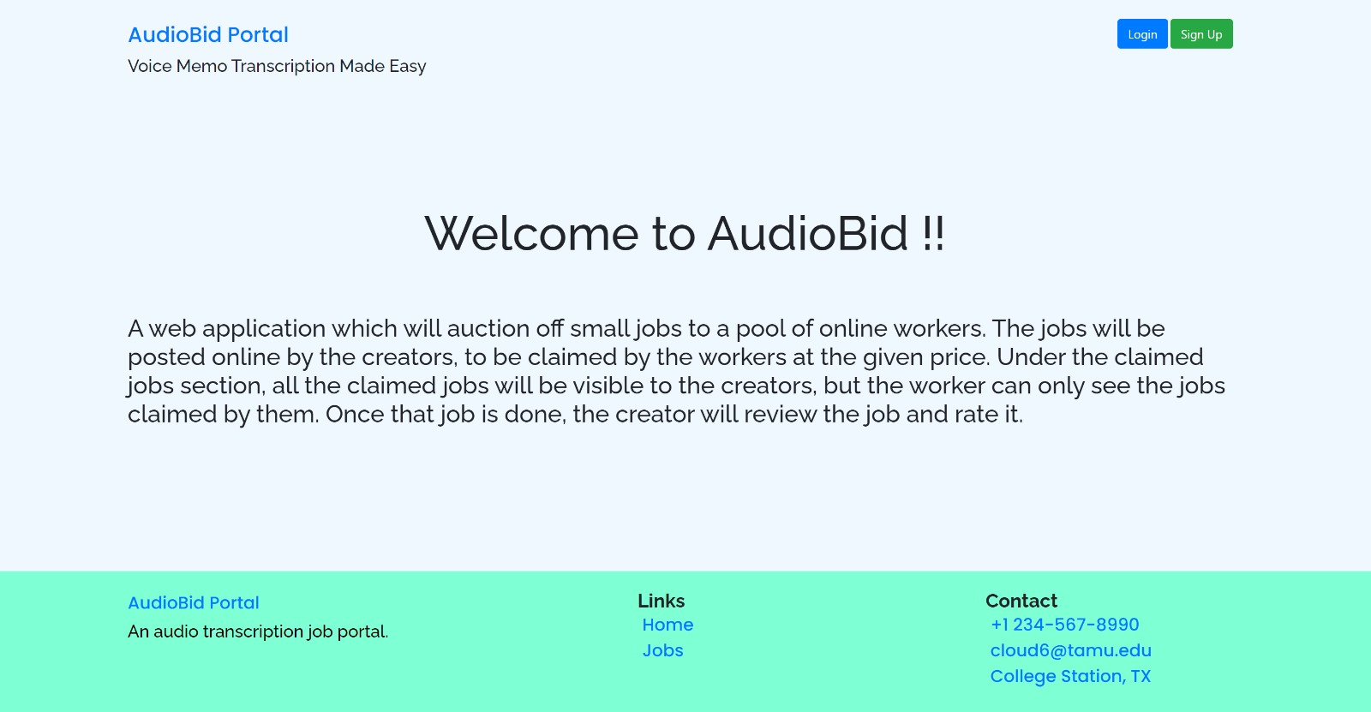
HomePage

Slide 7
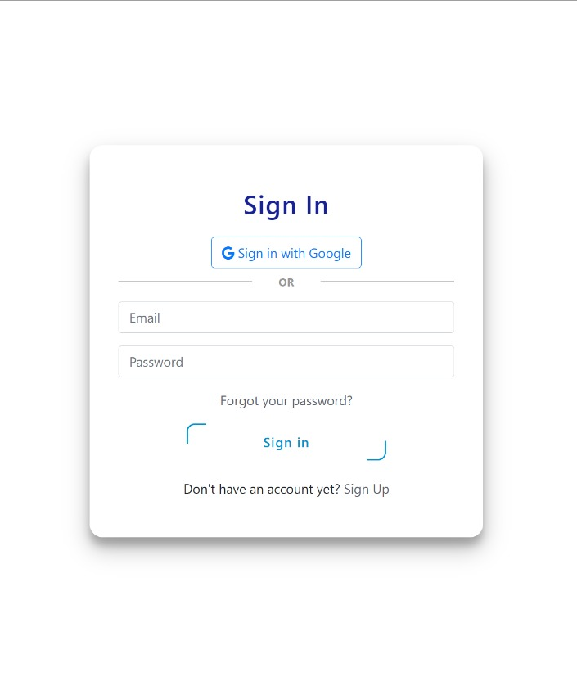
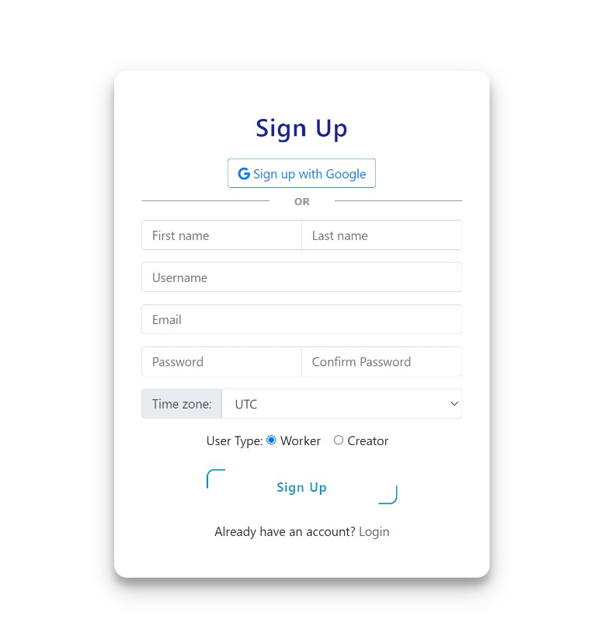
Sign in and Sign up(Native/Google)

Slide 8
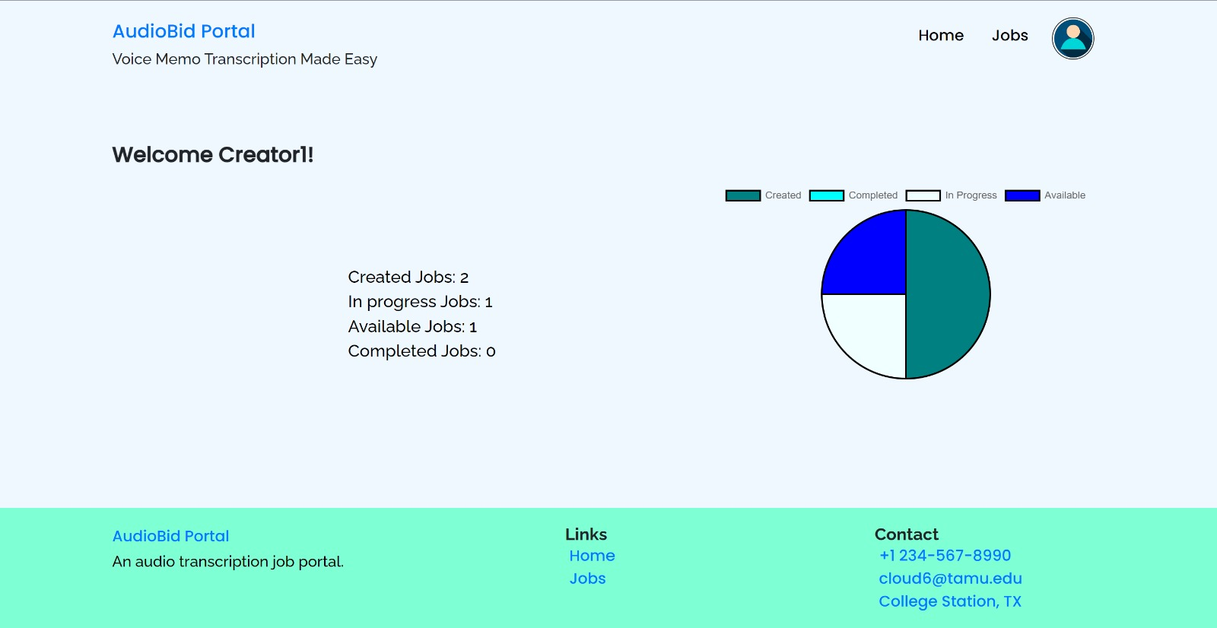
User HomePage (Logged in)

Slide 9
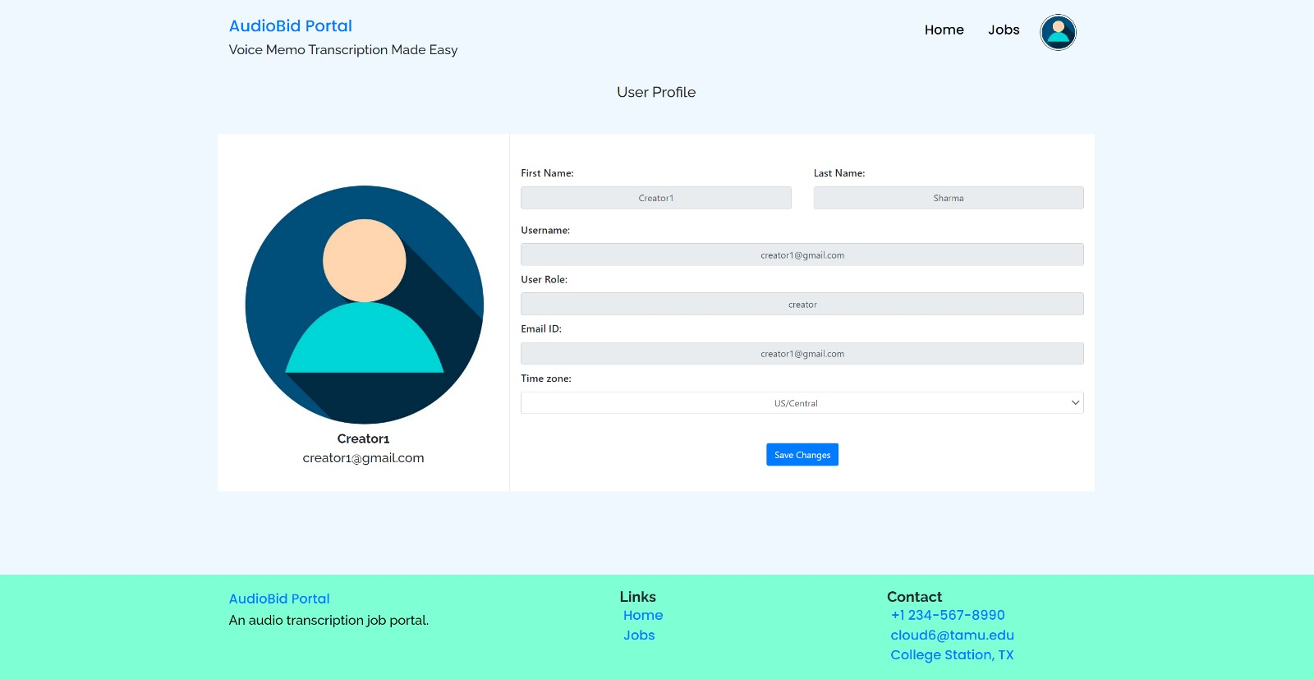
User Profile Page

Slide 10
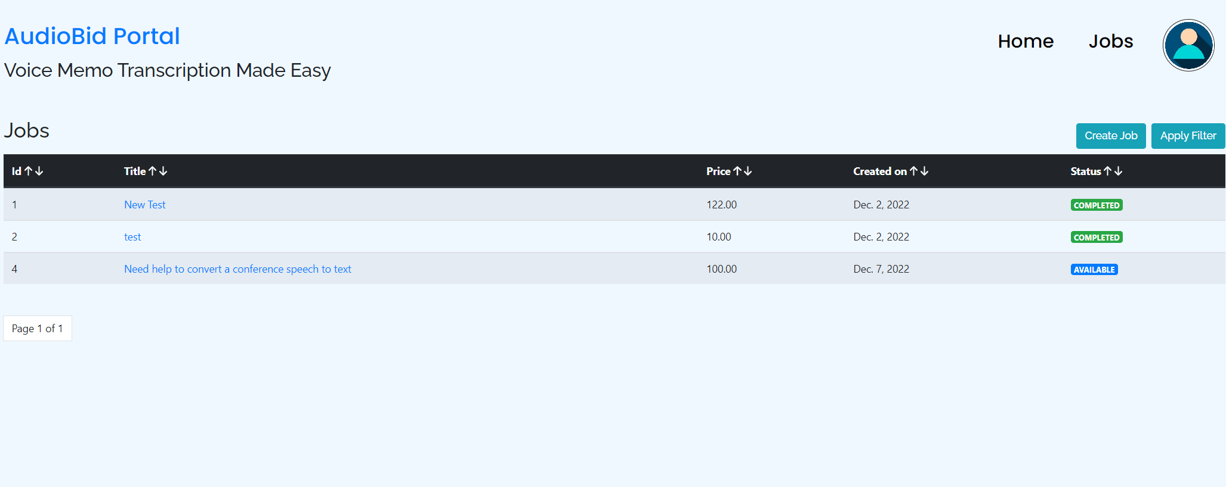
Jobs Page

Slide 11
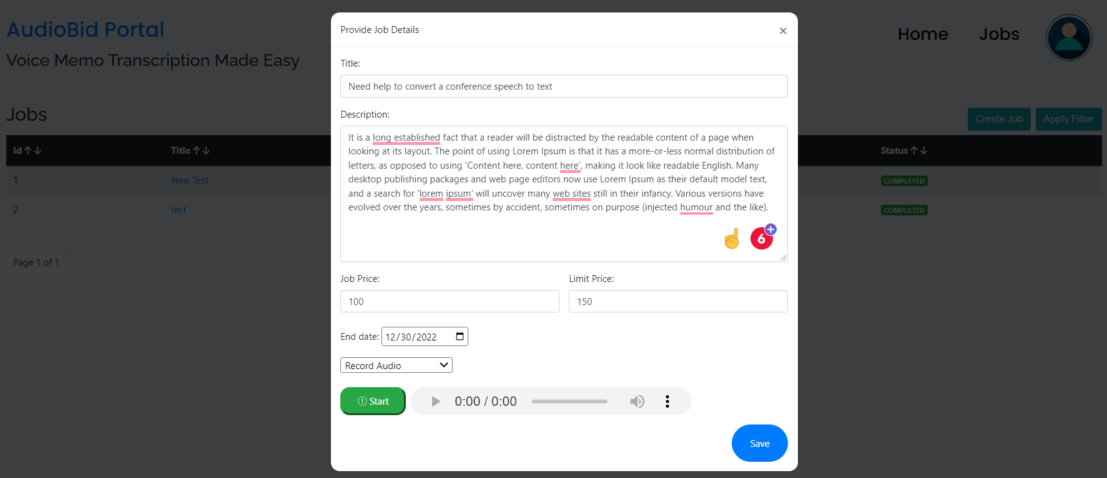
Creating Job

Slide 12
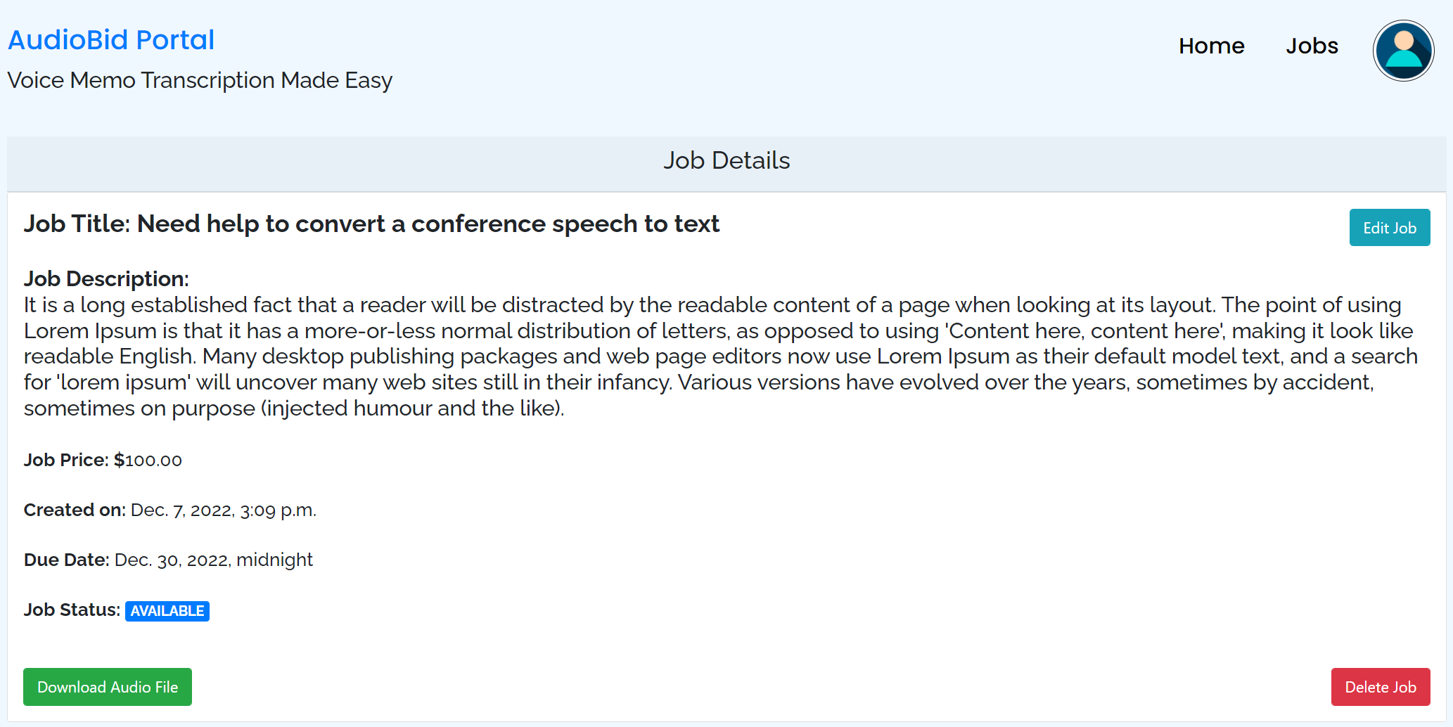
Job Details - Creator

Slide 13
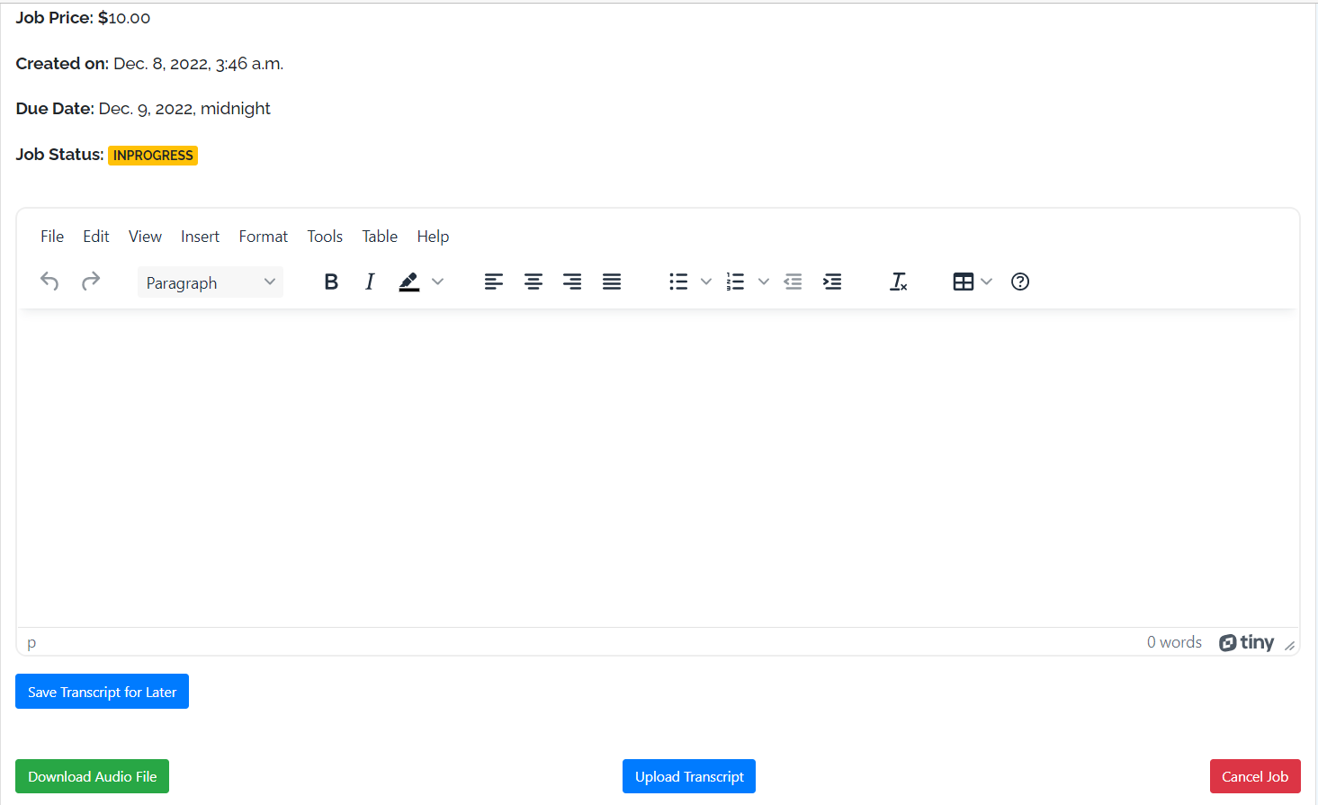
Job claim - Worker

Slide 14
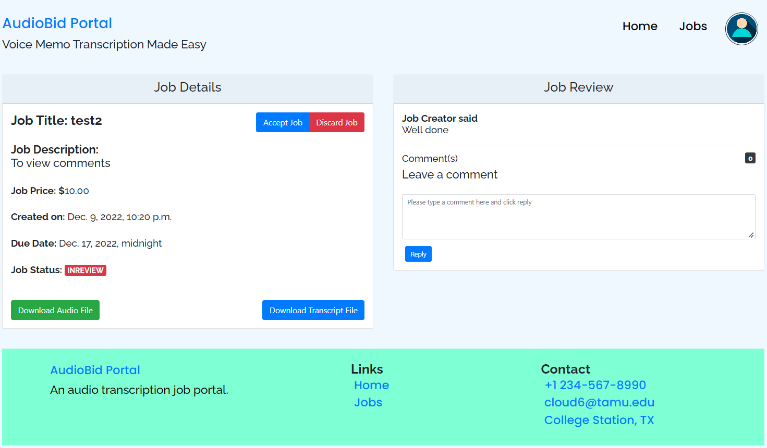
Review system

Slide 15
FUTURE
Job Biding
Payment System

Slide 16
Challenges and Lessons learnt
Django framework
Collaboration on the project
Code deployment
Testing the code

Slide 17
THANK YOU!
OUR TEAM:
Ajinkya Bharat Malhotra
Abhiraj Singh Rathore
Bhavya Rushin Shah
Neel Akash Murugesan Sathya Bama
Swatthi Vijay Sanker
Vasu Naman Verma

